Slide 1
SOMATIC SIMU
MUTATION SIGNATURE SIMULATOR FOR BENCHMARKING ALIGNMENT FREE MACHINE LEARNING CLASSIFICATION OF GENOMIC SIGNATURES
PROJECT UPDATE: AUGUST 7, 2020

Slide 2
Introduction
Mutation Signatures: overview
Somatic mutations in cancer genomes can have an exogenous and endogenous origin
Characteristic mutations lead to a signature
Signatures have unique identifying features that differ relative to other signatures
Figure 1. Catalogue of Mutations in Cancer Genomes
Source: https://software.broadinstitute.org/cancer/cga/msp

Slide 3
Introduction
Features of mutation signatures
Multiple mutational processes lead to superimposed signatures
Mathematical models estimate which mutations are attributed to which signature
Potential for classification
Figure 2: Set of single base substitution signatures and their kernel density estimate that contribute to the set of Skin-Melanoma whole genome sequences in the PCAWG dataset (n=107)

Slide 4
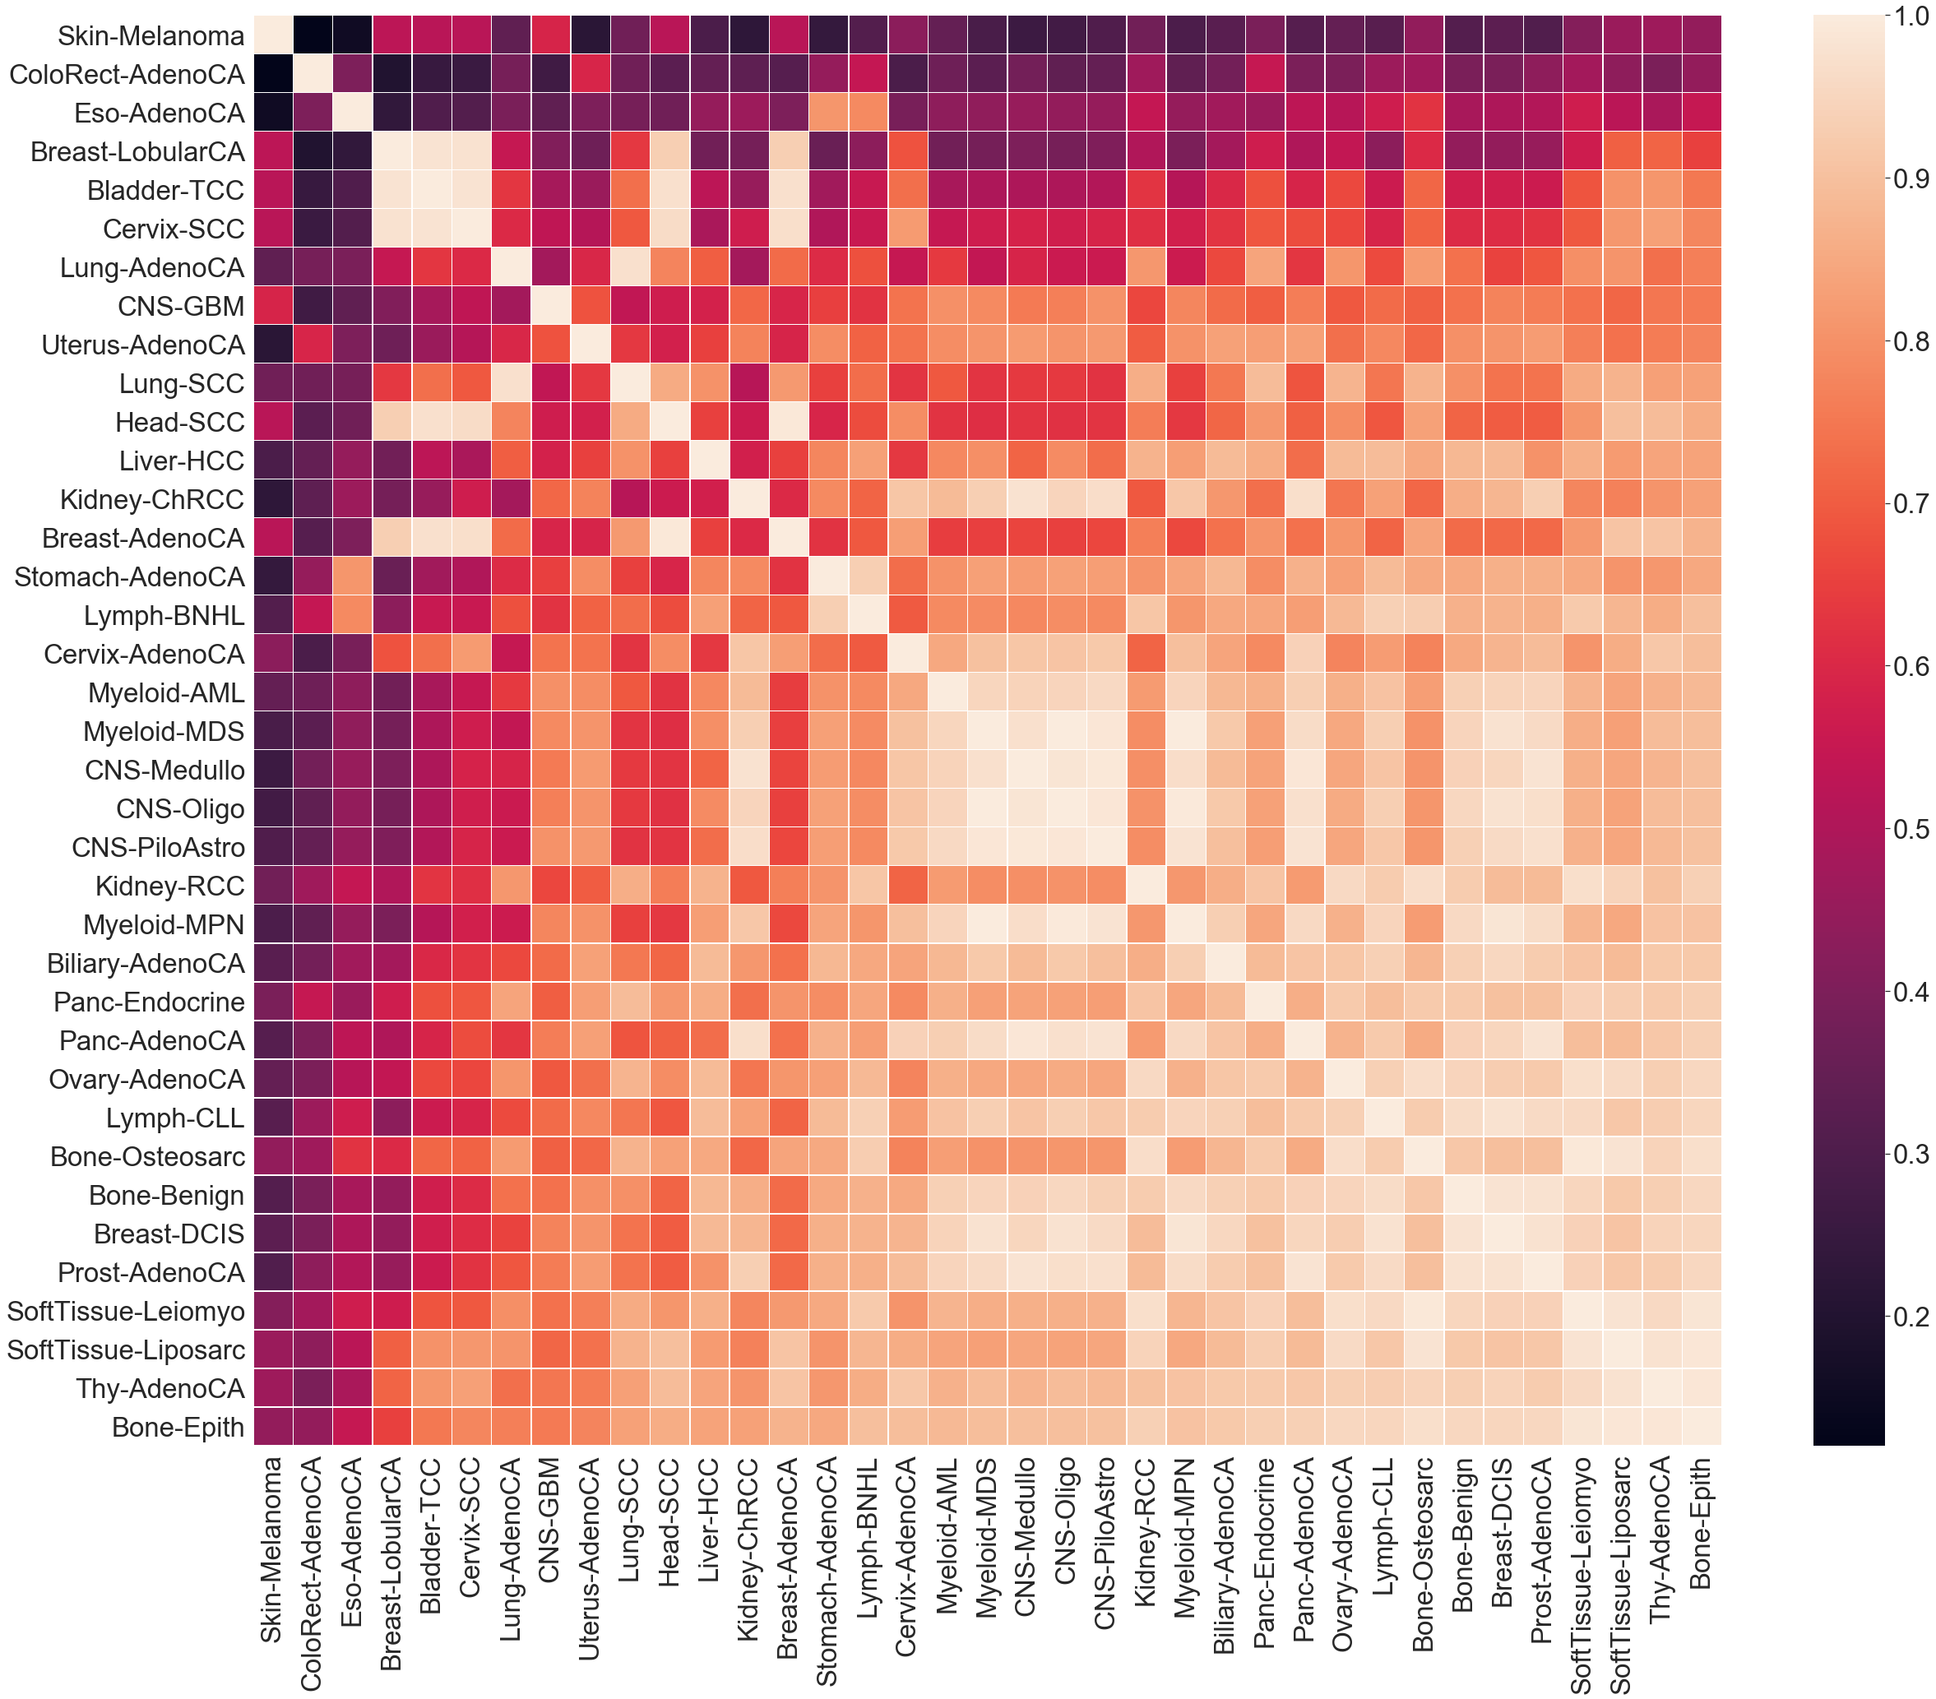
Visualization
Cosine Similarity of SBS Mutation PROFILE
Cosine similarity is metric used to compare the similarity of a multidimensional metric
Higher score indicates higher similarity between cancer types and more similar evolutionary trajectories

Slide 5
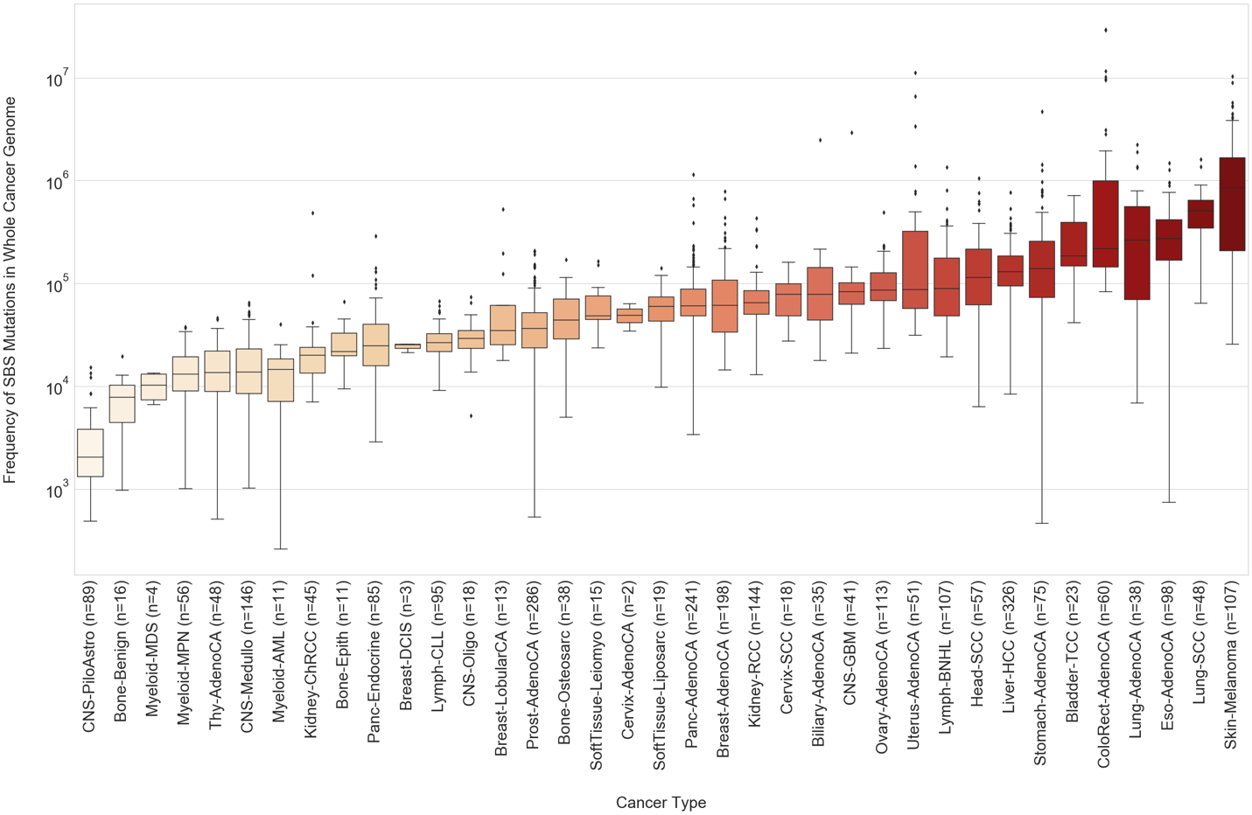
Visualization
SBS Mutation Burden in whole genome

Slide 6
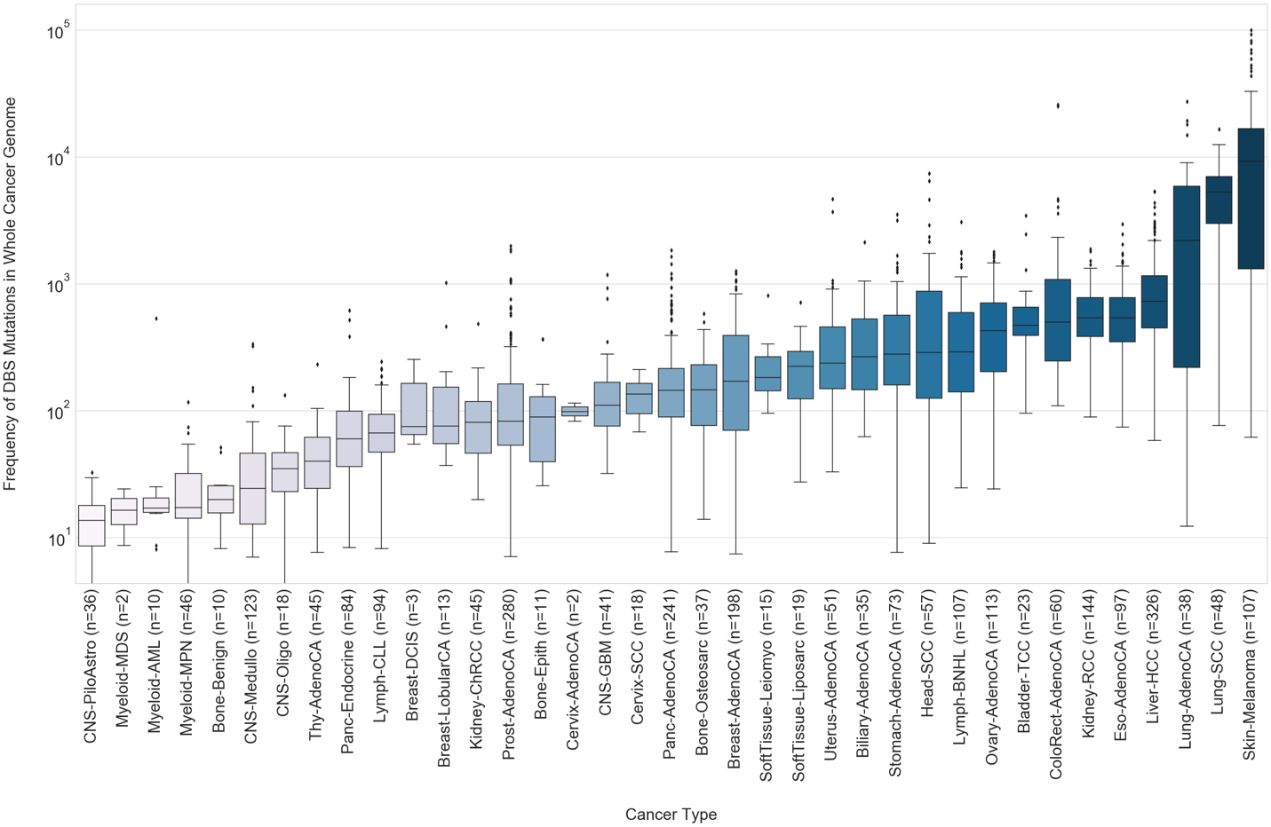
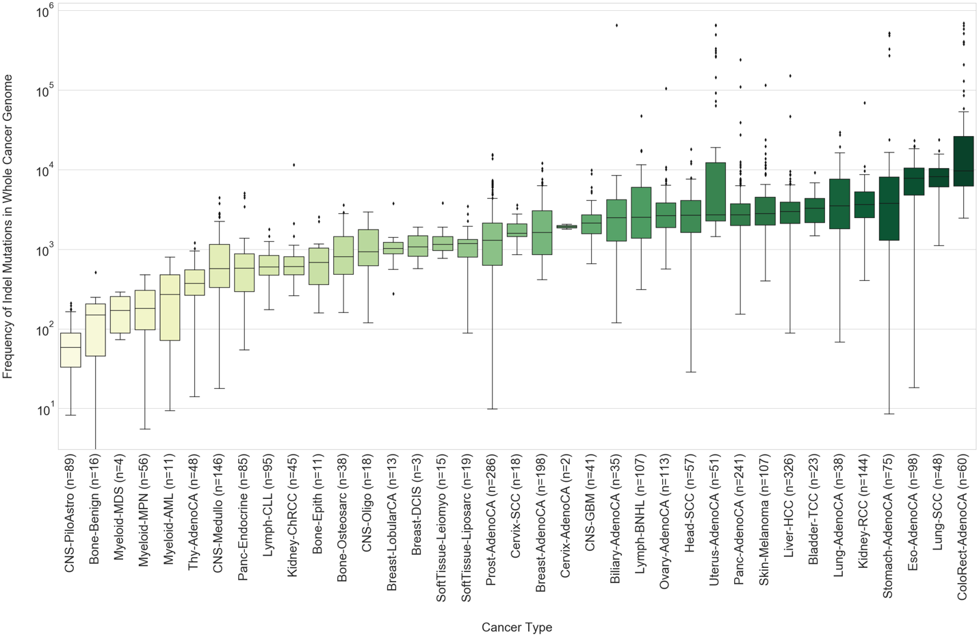
Visualization
DBS and Indel Mutation Burden in whole genome

Slide 7
Research Proposal
Research proposal
Genomic signatures have proven to be useful as methods for taxonomic classification
Alignment-free machine learning approaches can classify at the species level
Source: https://www.nature.com/articles/s41598-018-38157-3
Source: https://bmcgenomics.biomedcentral.com/articles/10.1186/s12864-019-5571-y
To what degree of accuracy and sensitivity can alignment-free machine learning approaches classify cancer whole genomic signatures?

Slide 8
Research Proposal
Use Case
Generated simulated cancer sequences as fasta files based on biologically representative frequencies of SBS, DBS and single- base indels
Benchmark the alignment-free machine learning with digital signal processing approach for sensitivity between different cancer types
Benchmark the alignment-free machine learning approach for accuracy across successive iterations of mutation signature simulation on the same sequence

Slide 9
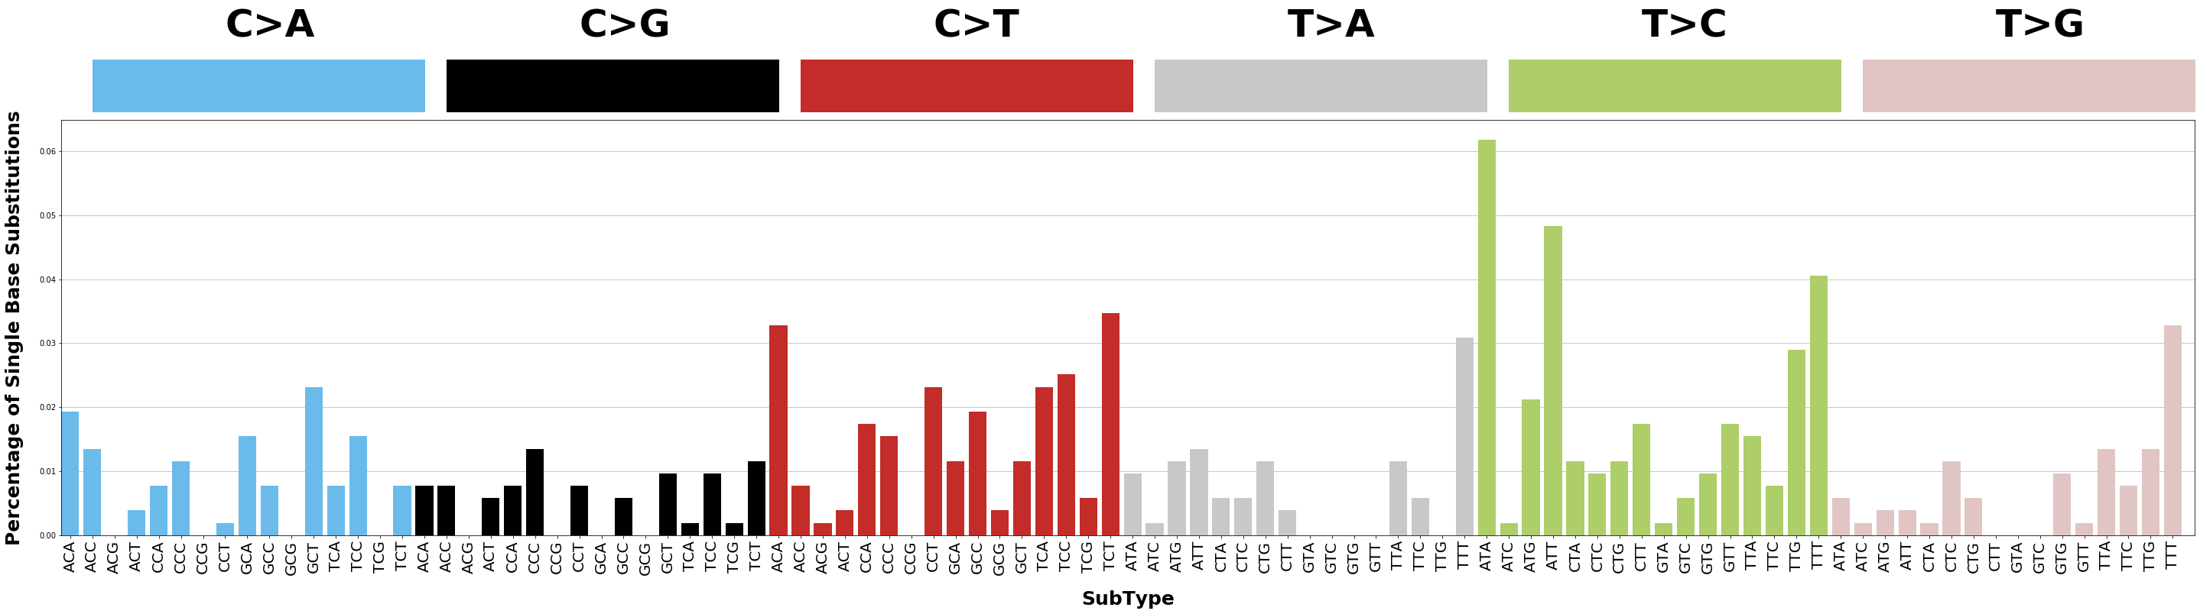
Somatic SiMu
Proof of concept: Liver-hcc
SomaticSiMu SBS Mutation Profile after 10 Generations of Simulation on Chromosome 22
COSMIC Mutation Profile for SBS5 and SBS12 active in Liver-HCC
Source: https://cancer.sanger.ac.uk/cosmic/signatures/

Slide 10
Next Steps
Parallel Directed evolution simulation
Iteration 1
Iteration 2
Iteration 3
Cancer
Type Signatures

Slide 11
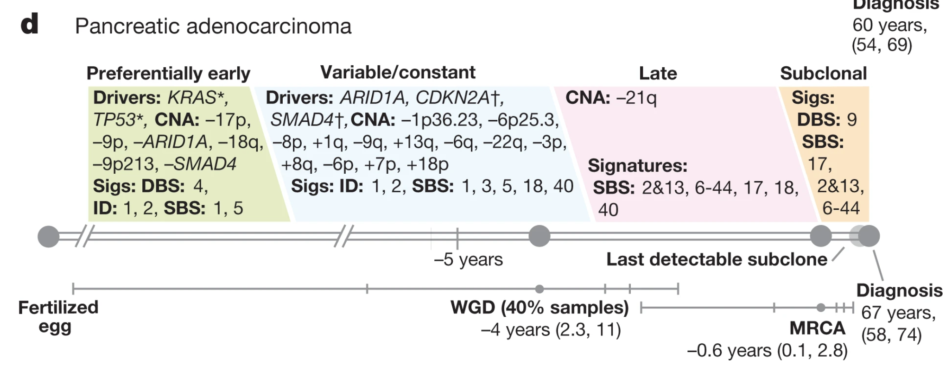
Next Steps
Current Limitations of Temporal Simulation
Total mutations for each sample in the dataset likely sampled at various stages of the cancer time course, skewed towards later stages
Incomplete PCAWG Timeline Info Dataset:
Missing values in dataset (2,778 samples with signature data):
Donour age at diagnosis: 2650
Donour survival time since diagnosis: 1754
Tumour stage: 1491

Slide 12
Next Steps
POTENTIAL future direction
Simulate two stages for each cancer type based on whole genome duplication status
Simulate single stage for each cancer type
Modifications to the original iterative and successive implementation of simulations across a time scale

Slide 13
Methods
PCAWG Dataset 1: Signature Decomposition
SigProfiler identifies SBS, DBS and indel mutations in whole cancer genome sequences and attributes each to a unique mutational signature
Unique sets of SBS
Signatures present:
SBS1, SBS2, SBS3, SBS5
SBS1, SBS2, SBS5
SBS1, SBS3, SBS5
SBS1, SBS3, SBS5
SBS1, SBS2
Table 1: SigProfiler SBS signatures in Bone-Osteosarcoma samples
Accession ID | Accuracy | SBS1 | SBS2 | SBS3 | SBS4 | SBS5
SP116499 | 0.955 | 248 | 155 | 2217 | 0 | 571
SP116505 | 0.949 | 283 | 85 | 0 | 0 | 679
SP116509 | 0.986 | 132 | 0 | 2608 | 0 | 1243
SP116437 | 0.956 | 179 | 39 | 0 | 0 | 440
SP116512 | 0.919 | 199 | 0 | 2810 | 0 | 32

Slide 14
Methods
PCAWG Dataset 2: Mutation attribution
SigProfiler characterizes the probability that any given mutation attributed to a signature is a specific Type and SubType
Table 2: SigProfiler 96-type SBS Signatures
Type | SubType | SBS1 | SBS2 | SBS3 | SBS4 | SBS5
C>A | ACA | 8.86E-04 | 5.80E-07 | 2.08E-02 | 4.22E-02 | 1.20E-02
C>A | ACC | 2.28E-03 | 1.48E-04 | 1.65E-02 | 3.33E-02 | 9.44E-03
C>A | ACG | 1.77E-04 | 5.23E-05 | 1.75E-03 | 1.56E-02 | 1.85E-03
C>A | ACT | 1.28E-03 | 9.78E-05 | 1.22E-02 | 2.95E-02 | 6.61E-03

